Slide 1
STATG019 – Selected Topics in Statistics 2015 Lecture 1
An Introduction to Kernels
Dr Franz J. Király

Slide 2
Scope of the course
Part 1: Kernel Methods (Franz)
Hands-on crash course on kernels
Focus on „data analysis“ part
Selection of practical kernel methodology
Complements well topics in COMPGI13
(by Arthur Gretton, focus on learning theory and hypothesis testing)
Part 2: Spatial Point Processes (Simon)
Replace „kernels“ above with „spatial point processes“

Slide 3
Course organization
On-line course moodle ID 16602
on-line activities, course info and materials
Lecture Wednesdays, 9 - 11 am
Attendance is mandatory
First lecture Jan 14, last lecture Mar 25 (no lecture in reading week)
Slides and course script available on moodle
Lecture is videotaped and availble on Lecturecast/moodle
Feel free to suggest content you want to learn about
Tutorials and/or practical sessions
Thursday, 11am - 1pm location varies
May take place irregularly, depending on demand
Attendance is non-compulsory
Discussion of theoretical or practical exercises, group presentations, etc…
Your choice.

Slide 4
Table of contents
Lecture 1: Introduction to kernels
Main concepts and theoretical results, learning guarantees
Kernel PCA and kernel ridge regression
Some notes on R and kernlab
Lecture 2: the kernel support vector machine
The linear support vector machine, duality
Hard- and soft-margin two-class SVM
The one-class SVM
Support vector regression
Lecture 3: Gaussian processes and kernel learning
Potential further lecture topics:
Algorithms: kernel discriminants, kernel k-means, kernel quantile regression kernel CCA, kernel MMD, kernel relevance vector machine
Large-scale learning with kernels, subset methods and Nyström-approximation
Combinatorial kernels: string kernels, graph kernels
Invariance kernels
Vapnik-Chervonenkis learning theory
Outlier detection, novelty detection
On-line kernel learning

Slide 5
An informal overview of things to come

Slide 6












Problem types in Statistical Machine Learning
Supervised
Some data is labelled by expert/oracle (mostly, training data)
?
?
?

Slide 7

Problem types in Statistical Machine Learning
Unsupervised
Data is not pre-labelled
?
?
!
!

Slide 8




What is Kernel Learning?
Most scalable algorithms employ linear principles
Most data exhibit non-linear features
Kernels allow to make linear algorithms work on non-linear features
Idea: replace scalar product in algorithm by “kernel product”
(this is neo-classical: Schölkopf 2002 – Learning with Kernels)
Example kernels:
“linear kernel” (nothing replaced)
“Gauss kernel” (measures closeness)
“homogenous polynomial kernel
“inhomogenous polynomial kernel
(measures shape)

Slide 9






The Kernel Trick
(classical, Aizerman et al 1964; Vapnik, 1995)
Kernel function is composition of “feature map” with scalar product
kernel feature map
v
v
Trick = linearization of algorithms operating with scalar products
“kernelization”
Example:
“homogenous polynomial kernel”
“Veronese map”

Slide 10





Kernelization
Kernels allow to make linear algorithms work on non-linear features
Idea: replace scalar product in algorithm by “kernel product”
Example: (ridge) regression
Input:
Output:
regressor function
“Kernelized” variant:
“kernel matrix”
“kernel evaluation vector”

Slide 11

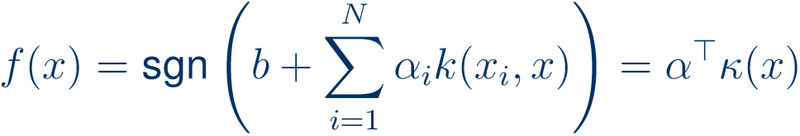
Kernelization
Example: support vector machine
Input:
Output:
separator/decision function
“Kernelized”, non-linear variant:
v
v

Slide 12
The kernel trick

Slide 13
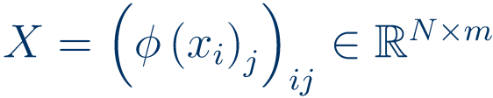
Most scalable algorithms employ linear principles
Most data exhibit non-linear features
Naïve idea to make non-linear algorithms:
This idea (with a bit of care) works, and is at the basis of a considerable part of modern statistics!
E.g., non-linear Tikhonov-regularized least-squares regression:
But there are issues with this approach:
This causes:
bad scaling/high runtime
overfitting (even with regularization)
badly conditioned matrices
lung cancer

Slide 14





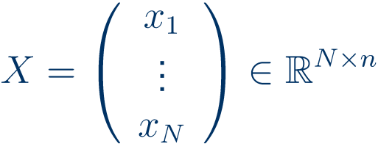
The kernel trick
(classical, Aizerman et al 1964; Vapnik, 1995)
Observation 1 (easy):
Example:
“homogenous polynomial kernel”
“Veronese map”
Observation 2 (difficult):
Many classical algorithms may be recast in scalar products only
Example 1: principal components
Example 2: ridge regression
(plus centering)
Bad news:
Good news:
they are very closely related

Slide 15













Theorem (Singular Value Decomposition):
(and usually ordered descendingly)
which is unique up to
orthogonal action on row-/column spaces
animation stolen from Wikipedia
Corollary (by “uniqueness”):
=
=
=
=
Inner product matrix!
This flavour of duality is at the core of ``kernelization’’.

Slide 16
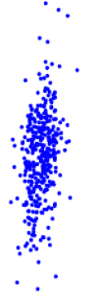










Kernelizing principal component analysis
Principal Component Analysis:
1.
compute:
2.
“Principal scores”:
Kernel Principal Component Analysis:
Observe:
where
and

Slide 17




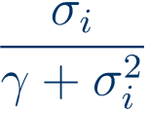



Kernelizing ridge regression
Ridge regression = Tikhonov-regularized OLS:
compute:
Prediction:
Kernel ridge regression (=kTROLS):
Note:
with this,
By symmetry of the expression,

Slide 18
The Reproducing kernel Hilbert space formalism

Slide 19





The kernel trick in RKHS-generality
Previously:
e.g.
Observation 3:
For example,
and works very nicely for clustering.
“Gauss kernel”
Definition:
Theorem (Moore-Aronszajn, 1950):
(up to isomorphism)
“reproducing (kernel Hilbert space) property”

Slide 20



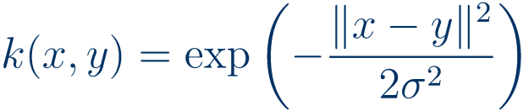
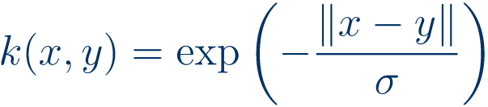
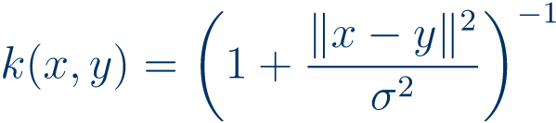



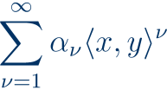


A (non-exhaustive) list of popular kernels
linear kernels
Radial basis function kernels
Dot-product kernels
homogenous polynomial kernel
inhomogenous polynomial kernel
sigmoid kernel (measures “contours”)
(both polynomial kernels measure “shape”)
not positive definite
Gaussian kernel
Laplacian kernel
Cauchy kernel
(these three measure “soft closeness”, with increasing long-range interaction/heavy tails from left to right)
Proposition:
(in case of convergence)
(in case of existence)

Slide 21



Example: polynomial feature map
kernel feature map
kernel feature map

Slide 22
Empirical risk minimisation and learning bounds

Slide 23


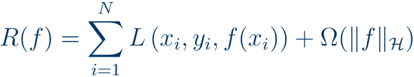


ridge regression finds a regressor function
Recall:
“empirical risk”
“regularizer”
Similarly, kernel ridge regression finds a regressor
One can show that we cannot do better under these circumstances:
Theorem (Kimeldorf-Wahba, 1971) “Representer Theorem”:
Statistical Learning Theory (Vapnik-Chervonenkis) quantifies

Slide 24



VC = quantiative form of Occam‘s razor
best fit
error
generalization error
overfitting
underfitting
training error
model complexity

Slide 25
kernlab

Slide 26
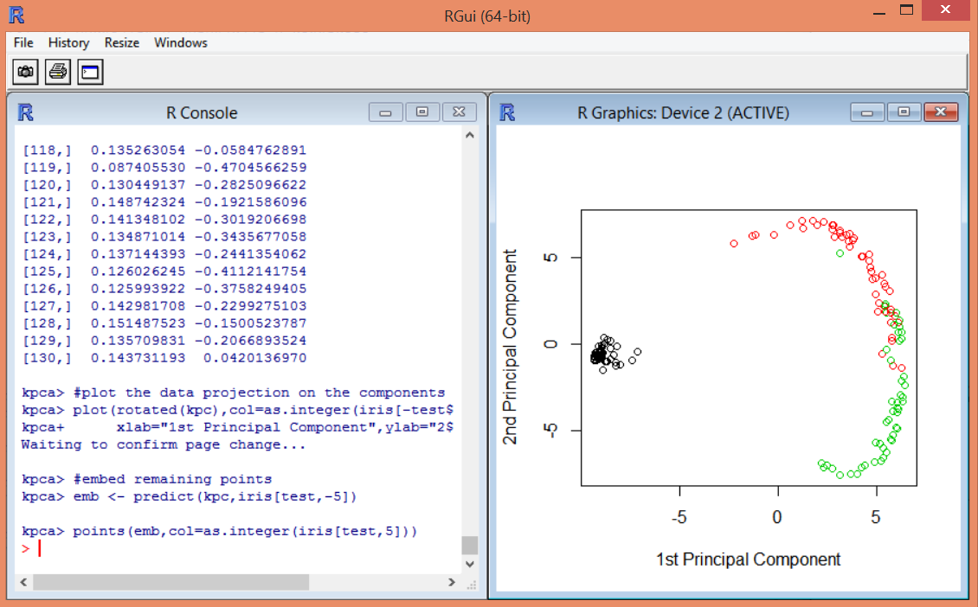
Working with kernlab under R
If you have not worked with R before or not much: look at STAT7001 materials or e.g. Dalgaard, introductory statistics with R
or type help.start() and click „an introduction to R“
type install.packages(kernlab) to install the kernlab package
After that library(kernlab) or require(kernlab) to use functions
Documentation: http://cran.r-project.org/web/packages/kernlab/kernlab.pdf
Try help(functionname) or example(fuctionname)

Slide 27
Outlook
Lecture 1: Introduction to kernels
Main concepts and theoretical results, learning guarantees
Kernel PCA and kernel ridge regression
Some notes on R and kernlab
Lecture 2: the kernel support vector machine
The linear support vector machine, duality
Hard- and soft-margin two-class SVM
The one-class SVM
Support vector regression
Lecture 3: Gaussian processes and kernel learning
Potential further lecture topics:
Algorithms: kernel discriminants, kernel k-means, kernel quantile regression kernel CCA, kernel MMD, kernel relevance vector machine
Large-scale learning with kernels, subset methods and Nyström-approximation
Combinatorial kernels: string kernels, graph kernels
Invariance kernels
Vapnik-Chervonenkis learning theory
Outlier detection, novelty detection
On-line kernel learning

Slide 28
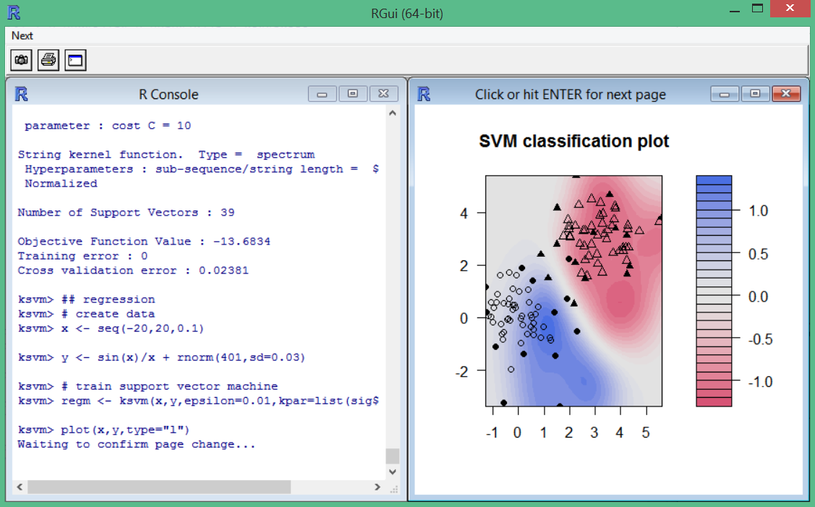
Next week:
the Silly Vapnik Machine

